Slide 1
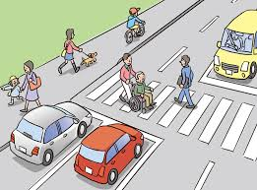
Final year project ADVANCE SYSTEM TO IMPLEMENT CONGESTION CONTROL AND TRAFFIC REGULATIONS
Guided by
Prof MEDHA SOMALWAR
Made by
Alok Yadav
Saad Shaikh
Zaid Shaikh

Slide 2
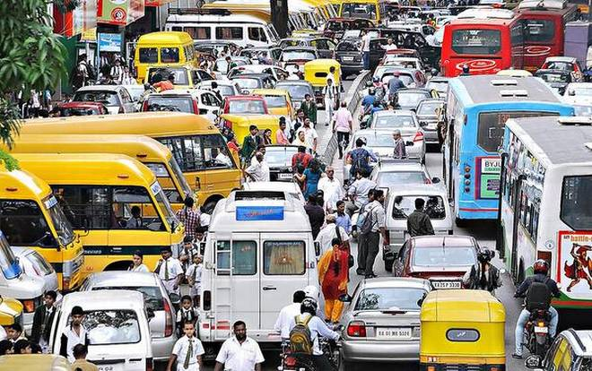
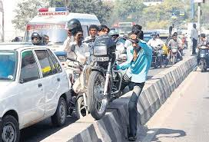
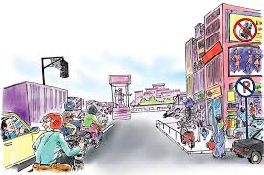
THE PROBLEM
Unnecessary traffic
Not following rules
Loop holes in the systems
Increased number of vehicles

Slide 3
PROPOSED SYSTEMS and SOLUTIONS
Smart traffic control system using real time video processing
Intelligent automatic traffic light controller
Intelligent traffic management using image processing
Smart traffic system using IoT
Adaptive traffic light timer control using Microcontroller and MATLAB

Slide 4
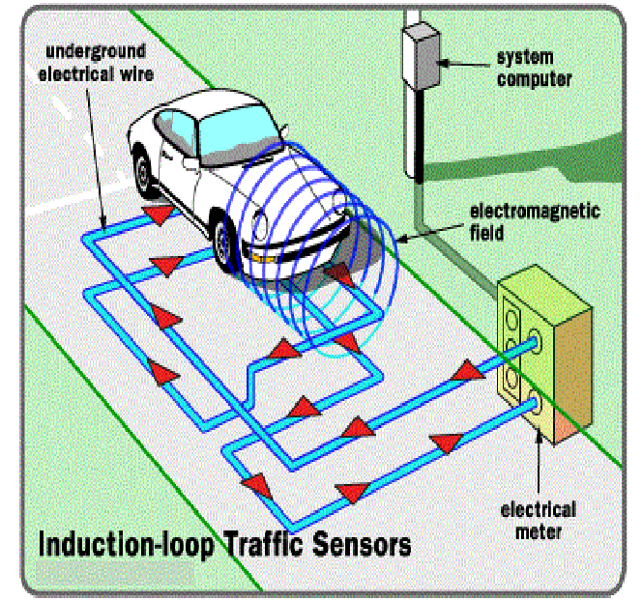
EXISTING SYSTEMS
HUMAN HANDLING OF TRAFFIC SYSTEM
OVERSPEEDING DETECTION USING RADAR AND CAMERA
CAMERAS ARE USED TO MONITOR TRAFFIC
INDUCTIVE LOOP TRAFFIC SENSOR

Slide 5

TECHNOLOGIES AVAILABLE
OBSTACLE AVOIDANCE USING RADAR
BUILT IN GPS FOR VARIOUS PURPOSES
SMART ALERTS
AUTOMATIC SPEED CONTROL USING RADAR
AUTOPILOT

Slide 6
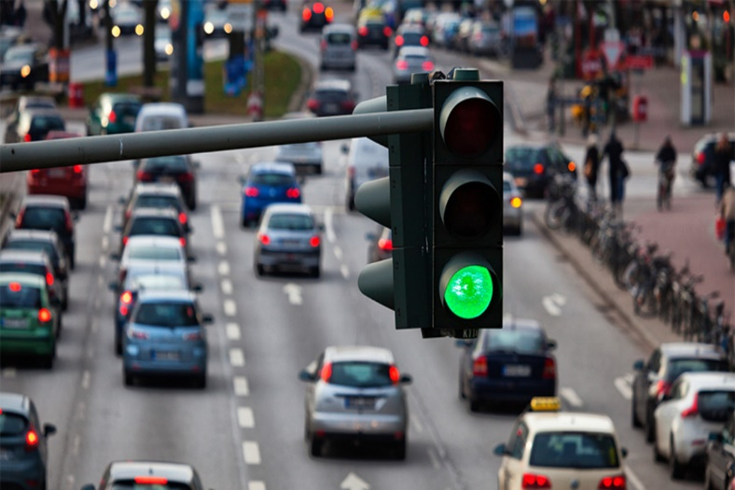
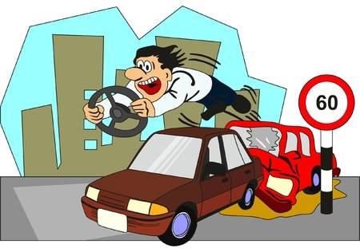
Our System
Using RFID to detect and reduce the vehicles breaking signals
Detect and prevent over speeding in the vehicle itself.
Signal Control based on traffic density

Slide 7

HOW OUR SYSTEM OVERCOMES THE PROBLEMS WITH EXISTING SYSTEM

Slide 8

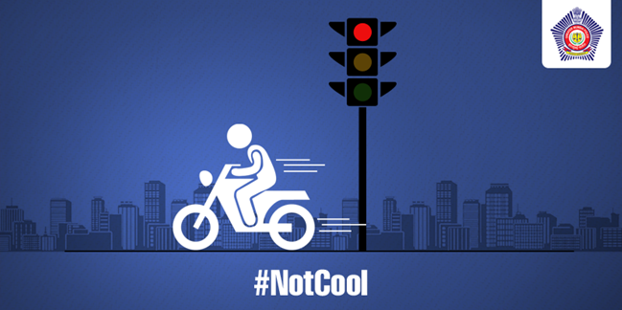
OVERSPEEDING…
In vehicle SENSOR

Slide 9

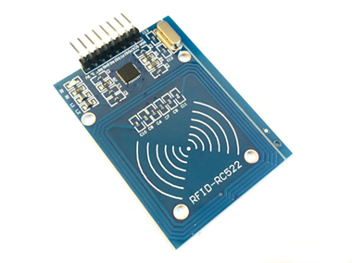
IMAGE PROCESSING VIDEO PROCESSING

Slide 10
COMPONENTS USED…

Slide 11

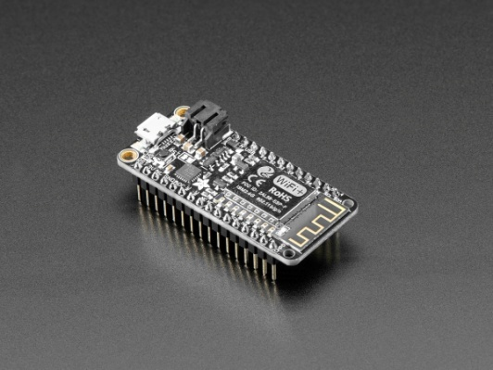
Goes Red
Signal
RFID activated
Vehicle crosses the line
Goes green
RFID deactivated
Tag will be identified
Data of the vehicle will be sent to the server/data base
DETECTION OF SIGNAL BREAKING USING RFID

Slide 12
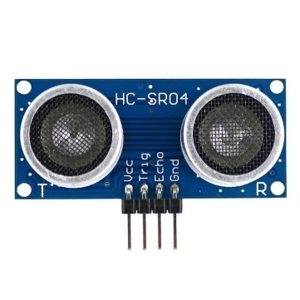
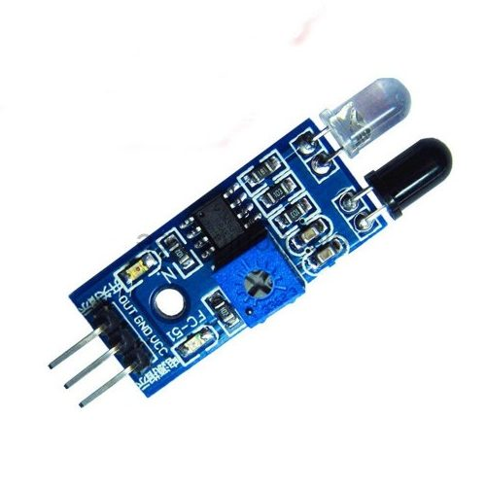
Sensor installed in the vehicle
Detects the speed of Vehicle
Processor checks the speed with threshold value
Speed<threshold
Speed>threshold
Processor detects Over speeding and sends data to Server/database
DETECTING OVER SPEEDING

Slide 13

Future Scope
Adaptive traffic signals
Real time traffic monitoring
Smart Corridors
Using GPS for preventing honking
Using GPS for Over Speed detection
Integration of sections

Slide 14
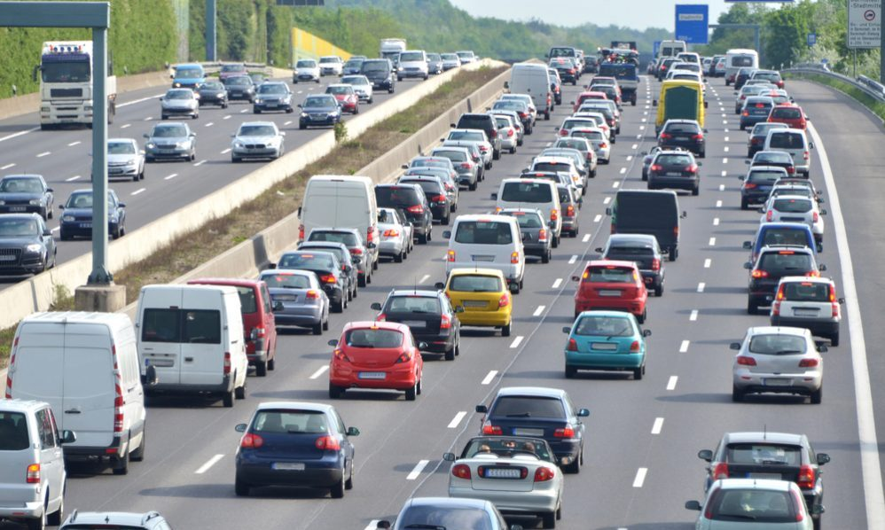
conclusion

